Slide 1
Rajasthan IT Day Hackathon:- Greenathon
Team Name:-
Roti_Kapda_Aur_Makan
By:-
Dhruv malik And Abhishek Barnwal
FarmerChain:- Collaborative​ ​ and​ ​ collective​ ​ pool​ ​ farming​ ​ system​ ​ with​ ​ built​ ​ in​ ​ blockchain​ ​ based​ ​ self​ ​ financing​ ​ system​ ​ to​ ​ help​ ​ farmers​ ​ become​ ​ self-reliant.

Slide 2
Farmer woes: Debt, Drought and Despair
1.Due to Dependence on the lenders charging uber interest rates and no farmer collaboration are the main causes of driving farmer to despair ( instead of innovate and increase the yield of crops per hectare they are in deep debt , causing suicides)
2. The government is just Decreasing the pain by waiving the loan but it is not a long term solution and economically Inefficient.

Slide 3
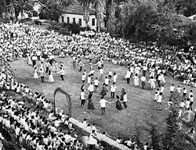
Solution:-
Making Decentralised cooperative society of farmers online so that they can pool their resources and can help each other by lending Money at attractive rates and also offer other services Like lending tools / offering to work for a project etc .
Eg:- Kibbutz ( an Ideal agriculture society of israel where the inhabitants contribute their effort in farms and get a fixed wage , Free housing and other resources determined by the commune.

Slide 4
Blockchain & smart contracts to the rescue
Type of data-structure storing immutable and connected records by cryptographic hashes. All the changes done in the ledger are implemented only after majority poling of the other farmers.
2.This helps to implement Democratic/ Decentralised organisations. Whose records cant be tempered or it cant be dominated by sheer resources
3. Also we can computer protocol intended to digitally facilitate, verify, or enforce the negotiation or performance of a contract(Called as Smart contract written in Solidity) thus contract can’t be ambiguous and biased

Slide 5

Our Solution:- FarmerChain
A decentralised Web app made on the Ethereum Blockchain . It has 3 parts :-
Farmer Bank:- It is a smart Contract used to maintain a Pool Of money ( generally given as a seed money by Govt/NGO and then farmer can give a small fee) for processing loan requests from the members. It follows certain constraints while giving loans :-
Only members can add funds or request loans
A member can request twice the amount he put in.
The maximum loan that is issued is half the total amount in the pool.
2. Also there are moderators which have the highest Privileges in adding new members or giving resolution of a dispute (Like that of judge in a district or state courts)

Slide 6
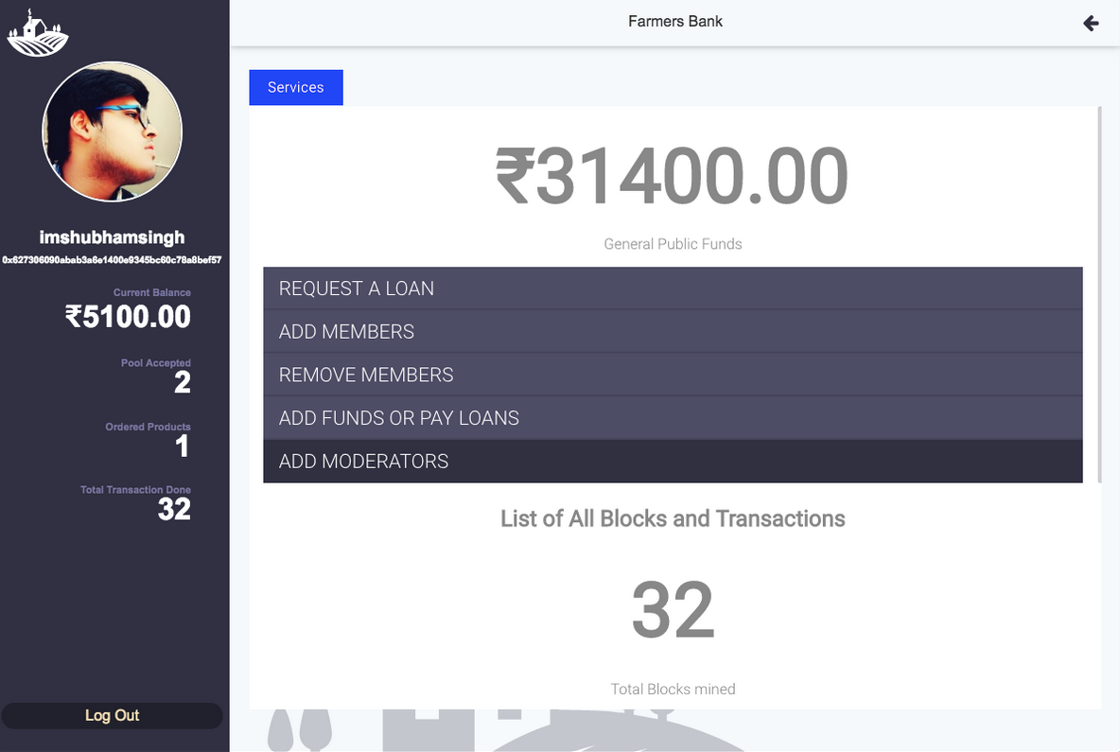

UI of an account (moderator/normal) account

Slide 7
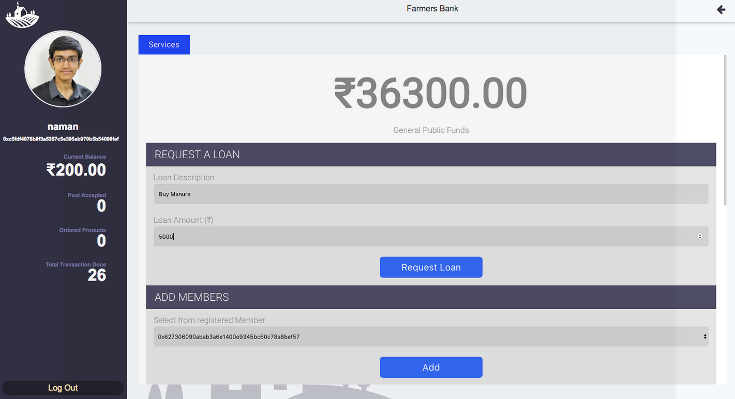
Ui for a Moderator/Borrower
User name and Credentails

Slide 8
2. Pool Farming:- a. It is a platform based on shared economy facilitating exchange of three different types of services: Hand, Machine and Storage.
b. Helps to optimize the requirements of resources so as to make the right use of money.
c. To validate the authenticity of pooling work , it has to be moderated By the other members in order to avoid spam.
d. The pooling work conditions (Deadline of work , other conditions) are embedded in a smart contract and thus will ensure that both the clients are bound to follow the set of rules and regulations.

Slide 9
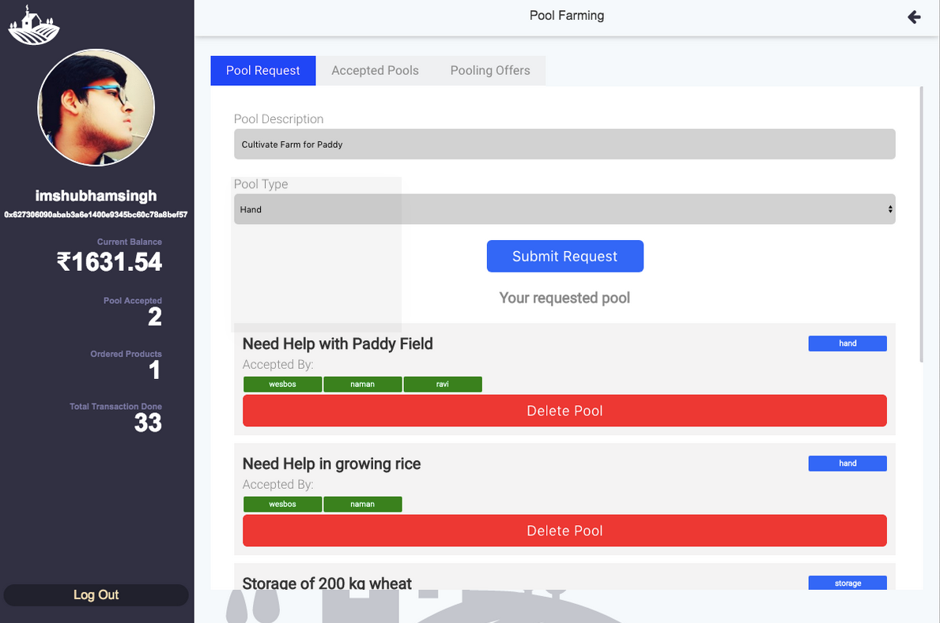
For doing or offering pooling work

Slide 10
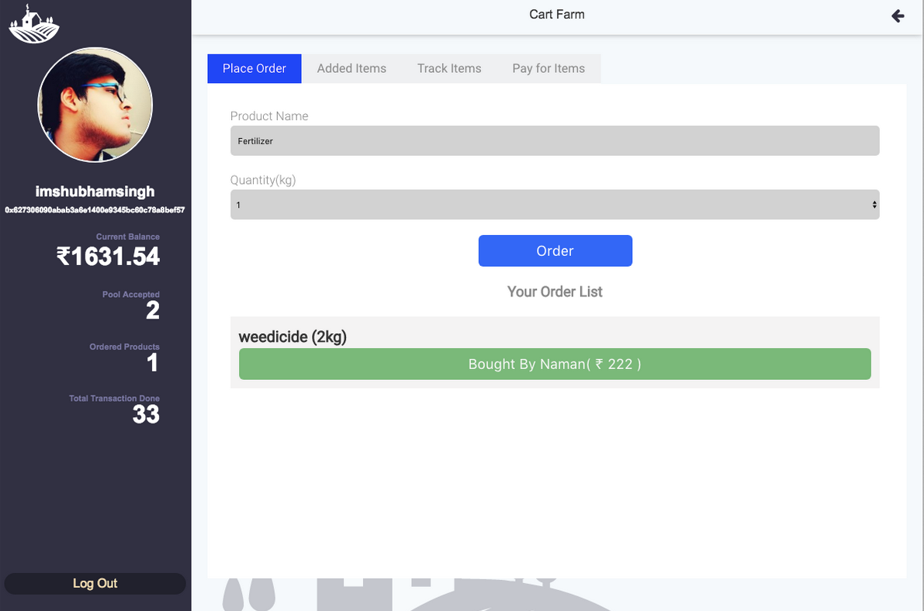
3. Cart of Farm
(i) It is a platform for requesting and outsourcing the need for bringing and delivering supplies

Slide 11
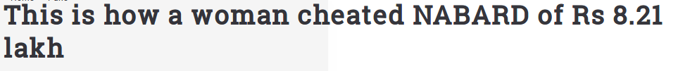
Applicability of the project.
As the apex body for giving financial credit to rural initiatives at no profit (NABARD) is overburdened by financial scams by numerous people duping bank with bogus proposals for loans and also crimes (like financial impropriety / giving unusual preference for financing rich corporates over poor farmers) shows that There is utmost need of the decentralized organisations so as to empower the farmers to take their decisions independently and collaborative way without the need of central govt Funds.

Slide 12
Possible additions and future scope.
Can Connect the farmer communities with Agrotech companies so as to implement latest techniques
Give credit rating of the farmers based on the payment of dues of the farmer so as to give them discounts
Use machine learning techniques to infer the data about the patterns of growth crops and thus help

Slide 13
Tech Stack Used
Front-End:-
Mockflow :- making experimental UI
1.React.Js:- for making Cross compatible and Interactive UI’s.
2. Web3.js:- It is a collection of libraries which allow you to interact with a local or remote ethereum node, using a HTTP or IPC connection.
3. HTML/CSS3:- front end website development .
Back-End:-
1.Truffle:- it is a compiler and debugger for Ethereum smart contracts and running a test suite
2.Webpack:- Another Ethereum based Module framework which is used to install the required dependencies in Truffle

